Slide 1
Password Manager
Carson
Intro
Team Organization
Software Requirements
Software Design
Test Overview
Traceability Matrix
Software Demonstration
Reflection
Members:
Andrew, Cameron, Jagger, Montana, Tristen, Carson, Miguel, Dakota, Chhavi, Sai

Slide 2
Intro
Team Organization
Software Requirements
Software Design
Test Overview
Traceability Matrix
Software Demonstration
Reflection
Carson
Index
01
03
06
08
14
19
23
24

Slide 3
Team Organization
INTRO
Team Organization
Software Requirements
Software Design
Test Overview
Traceability Matrix
Software Demonstration
Reflection

Slide 4
Team
Organization
INTRO
Carson
Team Organization
Followed the Agile methodology to enable iterative development. We utilized sprints to meet at least once a week to keep us on track.
Tools Used:
Wt Framework: Web application development.
SQLite: Secure data storage.
OpenBSD: Hosting for high security.
Training:
Basics of the Wt framework.
Writing secure SQL queries.
Web application security practices.
Version Control
Software Requirements
Software Design
Test Overview
Sub-Teams
Model Team - Jagger, Carson, Cameron, Chavi, Andrew
View Team - Jagger, Montana, Miguel, Sai, Cameron, Carson, Chavi, Tristen
Database Team - Andrew, Dakota, Tristen, Cameron, Sai
Test Team - Dakota, Miguel, Tristen, Montana, Carson
Merge Team - Andrew, Cameron, Jagger
Traceability Matrix
Software Demonstration
Reflection
Notes:
Are we listing who was in the sub-teams or just placing it the in general teams?

Slide 5
Software Requirements
INTRO
Team Organization
Software Requirements
Software Design
Test Overview
Traceability Matrix
Software Demonstration
Reflection

Slide 6
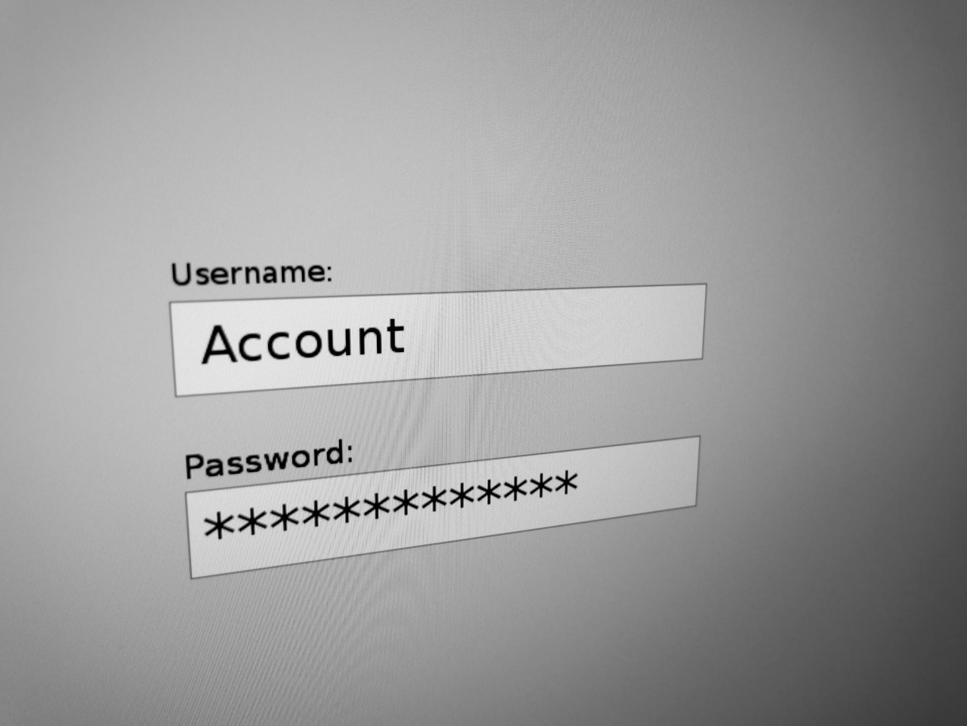
Purpose
INTRO
Miguel, Sai
Team Organization
The Shared Password Manager System helps users simplify password management by securely storing and organizing their credentials in one convenient place, allowing easy access whenever needed.
Key Objectives:
Admin Control: Admin users manage user accounts and roles.
Role-Based Features: Users have distinct permissions based on their roles, ensuring secure and efficient access.
Focus on Security: Implements encryption and secure access protocols to protect sensitive data.
Software Requirements
Software Design
Test Overview
Traceability Matrix
Software Demonstration
Reflection

Slide 7
Software
Requirements
INTRO
Sai
Non-Functional Requirements:
2. Security Measures
Daily backups and minimal database access privileges for data protection.
Implemented AES encryption for all data transfers and password storage.
3. Performance
System uptime goal of 99.99%.
Maximum 2-second response time.
Manages multiple user actions simultaneously
Team Organization
Software Requirements
Store user credentials securely with role-based access.
Functional requirements:
1. Privilege Separation
Admin can manage users.
Regular users can view, add, and edit credentials.
View-only users can only view credentials.
Software Design
Test Overview
Traceability Matrix
Software Demonstration
Reflection

Slide 8
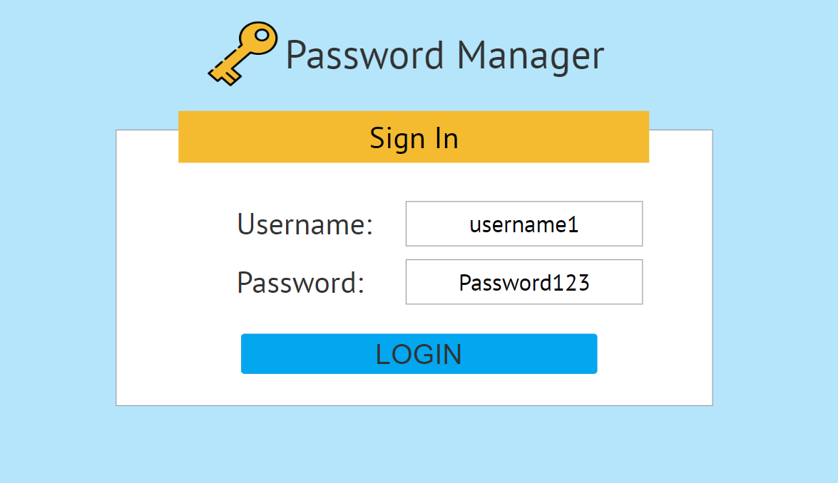
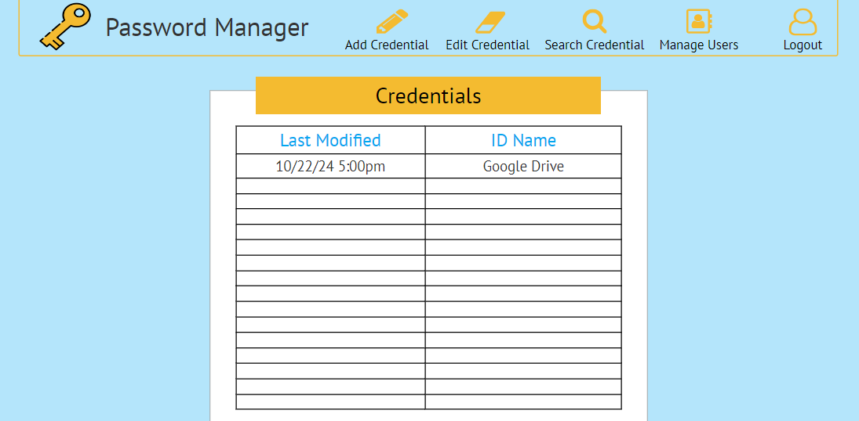
INTRO
Dakota, carson
Team Organization
Software Requirements
Software Design
Test Overview
Traceability Matrix
Software Demonstration
Reflection

Slide 9
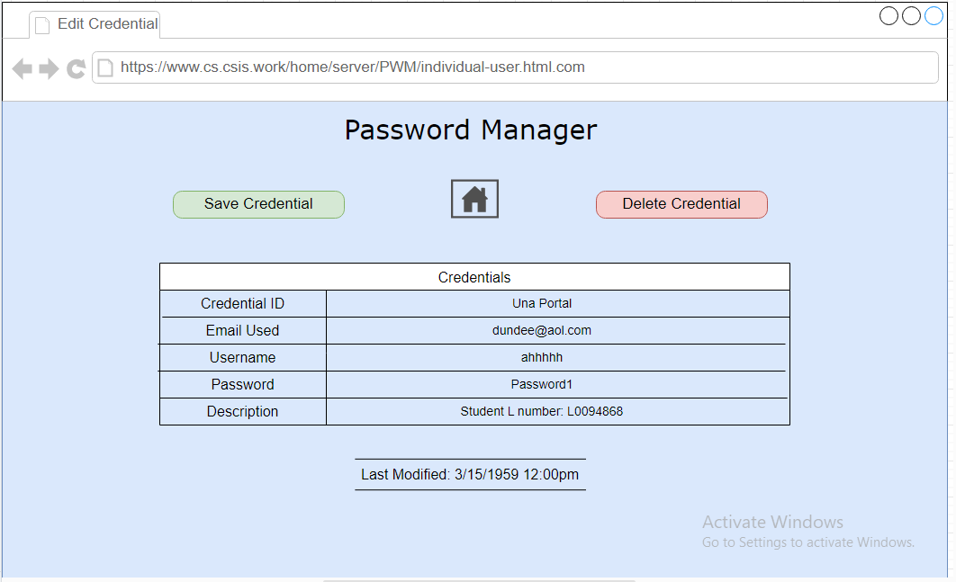
INTRO
Dakota, carson
Team Organization
Software Requirements
Software Design
Test Overview
Traceability Matrix
Software Demonstration
Reflection

Slide 10
Software Design
INTRO
Team Organization
Software Requirements
Software Design
Test Overview
Traceability Matrix
Software Demonstration
Reflection

Slide 11
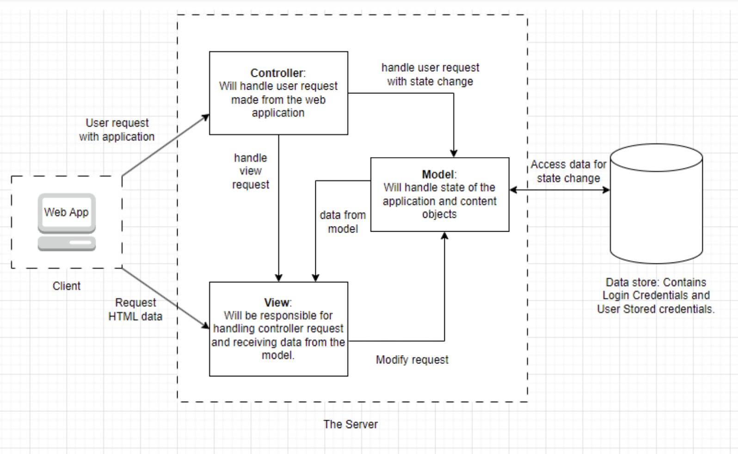
MVC ARCHITECTURE DIAGRAM
INTRO
Jagger
Team Organization
Software Requirements
Software Design
Test Overview
Traceability Matrix
Software Demonstration
Reflection
Notes:
Model
The model handles data retrieval, modification, and storage.
Our model includes the object classes, hashing functionality for passwords, and the database.
View
The view handles the presentation of data to the user.
Our view includes the form classes that use inheritance to avoid redundant code
Controller
The controller acts as an intermediary between the model and the view
Our application does not have dedicated controller
The control is handled by witty and user-defined functions within the view classes
Flow of Information in MVC
The user interacts with the view
The controller processes the input and takes action
The model updates its data and notifies the view
The view fetches updated data from the model and refreshes the user interface
Example flow in our application - Adding a credential
The user fills out required fields and clicks the add button
Witty acts as the controller, and calls the “addNewCredential()” function that is connected to the button
The credential is added to the database in the model
The view now displays the added credential to the list of credentials
Conclusion - Advantages of using the MVC architecture
Separation of concerns - This allowed us to easily separate into teams based on previous experience and strengths
Testability - Each component could be tested separately before integration

Slide 12
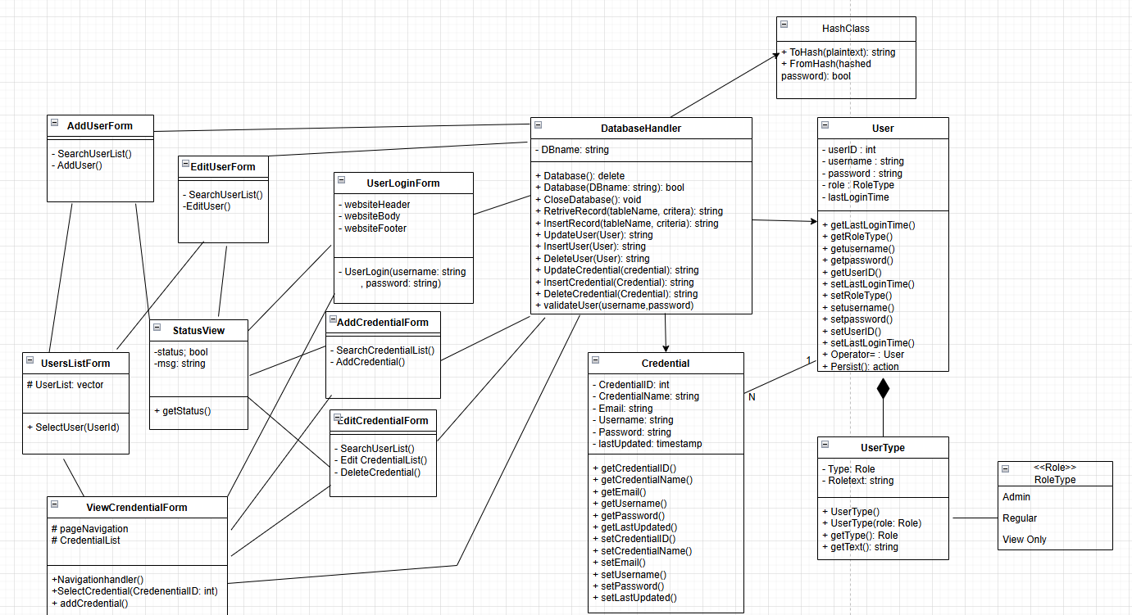
Design Overview:
INTRO
Jagger, Andrew, Montana
Team Organization
Software Requirements
Software Design
Test Overview
Traceability Matrix
Software Demonstration
Reflection

Slide 13
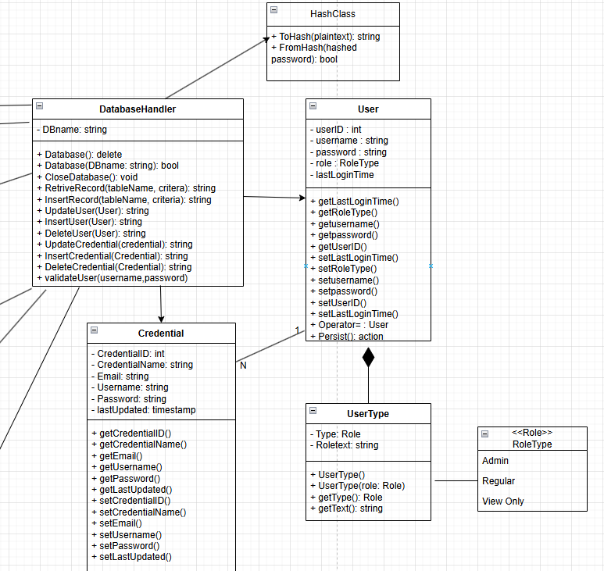
Model Breakdown:
INTRO
Andrew, Miguel, Jagger, Dakota
Team Organization
How it works?
ModelControl
Design decisions
Software Requirements
Software Design
Test Overview
Traceability Matrix
Software Demonstration
Reflection

Slide 14
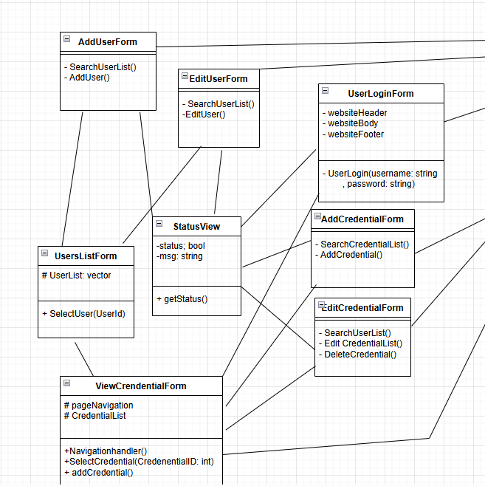
View Breakdown:
INTRO
Montana, Tristen, Cameron
Team Organization
How it works?
App driver
Css
Software Requirements
Software Design
Test Overview
Traceability Matrix
Software Demonstration
Reflection
Notes:
Basically we have one file acting as the front end driver that contains an internal path change function that makes calls to functions of other files to create views. This main driver also handles the user login form.
We had a status view file that was able to accept a boolean and a string message to create status views for when the user submits changes or searches (the success or failure messages).
We also created two forms, the user and credential form that set up the text labels, text boxes, and buttons which created the base of all other views.
Cam’s styling shrooms (CSS);
Attempted an external style sheet but did not work as intended, so went with a similarly modifiable method of using inline edits.
Inline styling is subject to each individual container on the website, each container has their own characteristics.
The containers are as described by their name, the header and navigation are technically in the same container but their own containers.

Slide 15
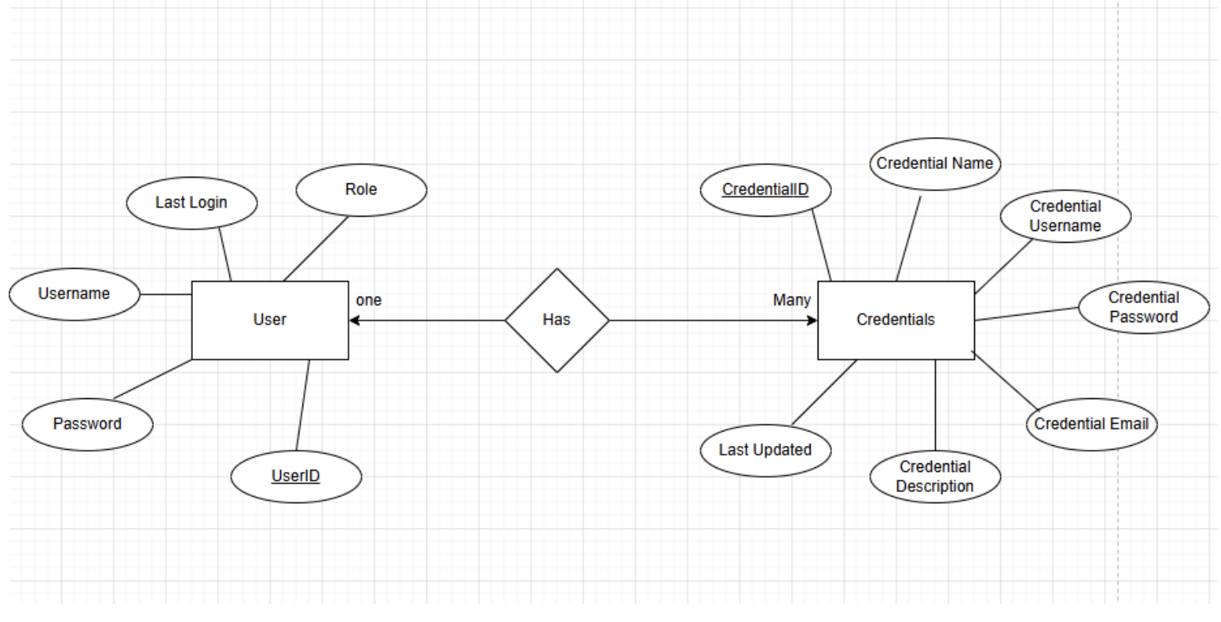
E/R Diagram
INTRO
Tristen, Andrew
Team Organization
Software Requirements
Software Design
Test Overview
Traceability Matrix
Software Demonstration
Reflection

Slide 16
Test Overview
INTRO
Team Organization
Software Requirements
Software Design
Test Overview
Traceability Matrix
Software Demonstration
Reflection

Slide 17
Model Unit Test Results
INTRO
Andrew, Miguel, Tristen
Team Organization
All unit tests were conducted with gtest
Software Requirements
User Class Tests | Constructor And Getters | M1 | This test shall test the Constructors and the Getter functions of the User Class | Pass
 | Update Last Login | M2 | This test shall test the UpdateLastLogin function of the User Class | Pass
 | Operator | M3 | This test shall test the overloaded operator of the User Class | Pass
UserType Class Tests | Constructor And Getters | M4 | This test shall test the Constructors and the Getter functions of the UserType Class | Pass
Software Design
Test Overview
Traceability Matrix
Software Demonstration
Reflection

Slide 18
Model Unit Test Results
INTRO
Andrew, Miguel, Tristen
Team Organization
Credential Class Tests | Constructor And Getters | M5 | This test shall test the Constructor and Getter functions of the Credential Class | Pass
 | Update Last Updated | M6 | This test shall test the UpdateLastUpdated function of the Credential Class | Pass
 | Setters | M7 | This test shall test the Setter functions of the Credential Class | Pass
Database Tests | Constructor | M8 | This test shall test the Constructor for the Database | Pass
 | Insert Record | M9 | This test shall test the InsertRecord function for the Database | Pass
 | Retrieve Record | M10 | This test shall test the RetrieveRecord function for the Database | Pass
 | Update Record | M11 | This test shall test the UpdateRecord function for the Database | Pass
 | Delete Record | M12 | This test shall test the DeleteRecord function for the Database | Pass
Software Requirements
Software Design
Test Overview
Traceability Matrix
Software Demonstration
Reflection

Slide 19
Model Unit Test Results
INTRO
Andrew, Miguel, Tristen
Team Organization
Hash Class Tests | To Hash Returns Correct Hash | M13 | This test shall test the ToHash function of the HashClass | Pass
 | From Hash Validates Correctly | M14 | This test shall test the FromHash function of the HashClass, for a correct password entry | Pass
 | From Hash Fails On Incorrect Password | M15 | This test shall test the FromHash function of the HashClass, for an incorrect password entry | Pass
 | To Hash Different Passwords Produce Different Hashes | M16 | This test shall test the ToHash function of the HashClass, ensuring each password receives a unique hash. | Pass
Software Requirements
Software Design
Test Overview
Traceability Matrix
Software Demonstration
Reflection

Slide 20
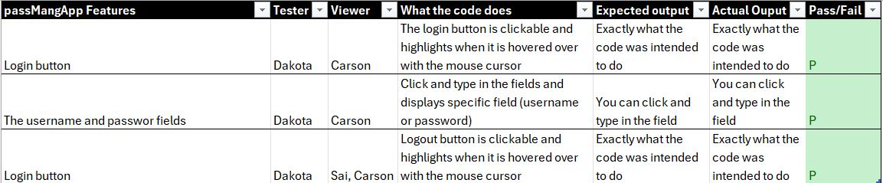
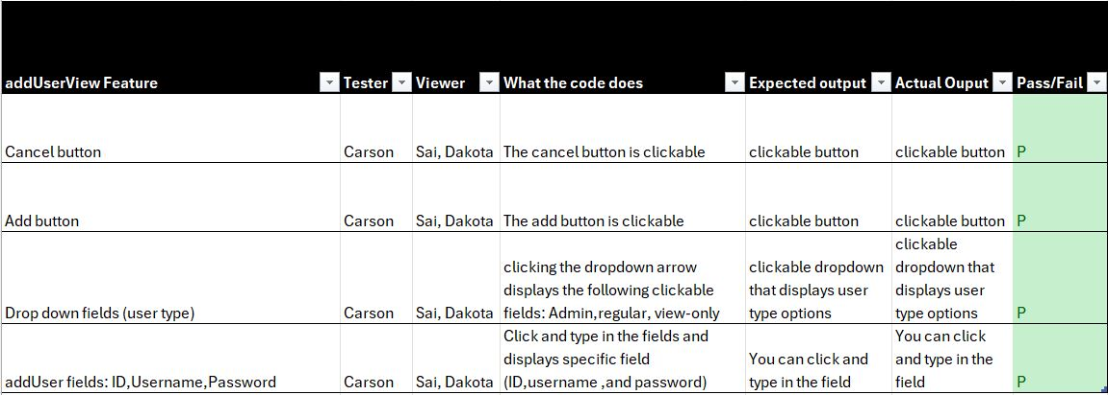
View Unit Test Results
INTRO
Dakota, Carson, Sai
Team Organization
V1.
Software Requirements
V2.
V3.
Software Design
Test Overview
V4.
Traceability Matrix
V5.
V6.
Software Demonstration
V7.
Reflection

Slide 21
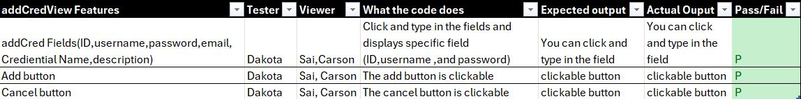
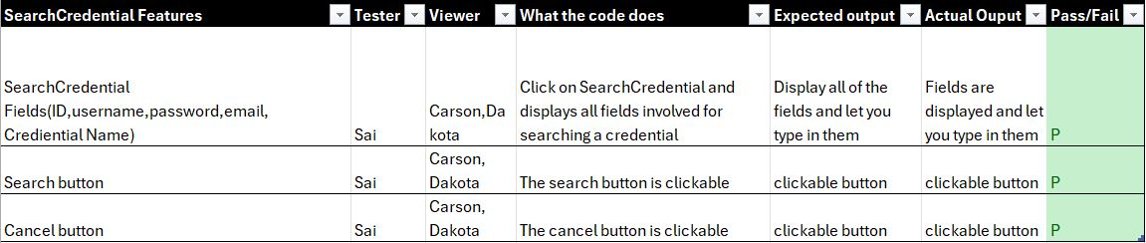
View Unit Test Results
INTRO
Dakota, Carson, Sai
Team Organization
V8.
Software Requirements
V8.
V9.
Software Design
Test Overview
V10.
Traceability Matrix
V11.
V12.
Software Demonstration
Reflection

Slide 22
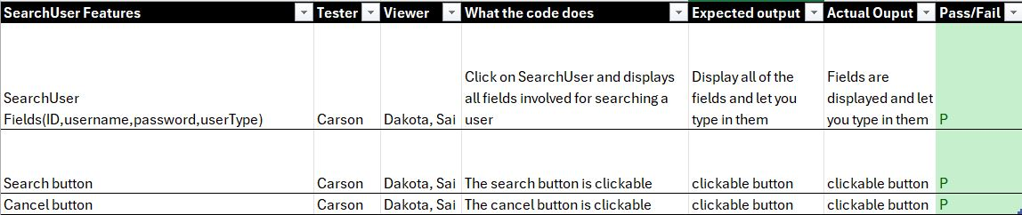
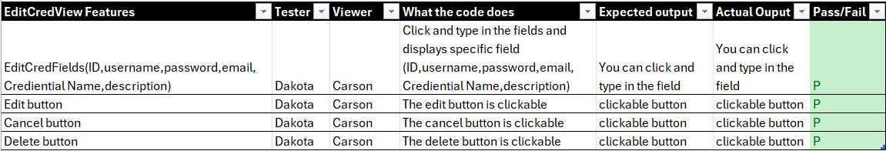
View Unit Test Results
INTRO
Dakota, Carson, Sai
Team Organization
V14.
Software Requirements
V15.
Software Design
V16.
Test Overview
Traceability Matrix
V17.
V18.
Software Demonstration
V19.
V20.
Reflection

Slide 23
View Unit Test Results
INTRO
Dakota, Carson, Sai
Team Organization
Software Requirements
Software Design
V21.
Test Overview
V22.
V23.
Traceability Matrix
V24.
Software Demonstration
Reflection

Slide 24
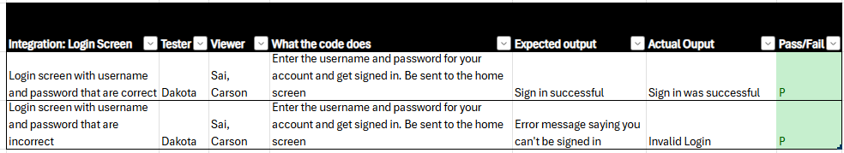
Integration Test Results
INTRO
Dakota, Carson, Sai
Team Organization
Software Requirements
IT 1.
Software Design
IT 2.
Test Overview
Traceability Matrix
IT 3.
Software Demonstration
Reflection

Slide 25
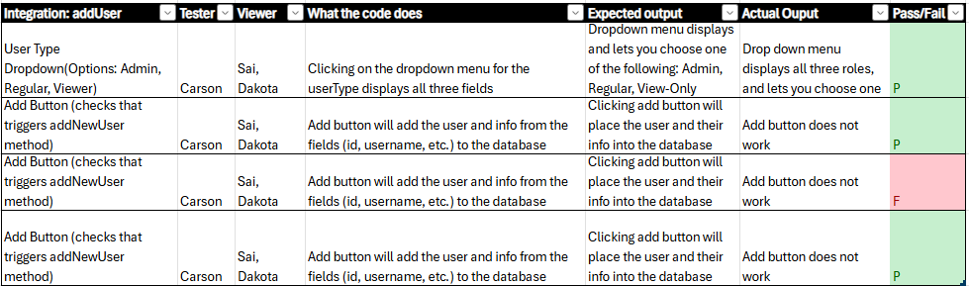
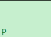
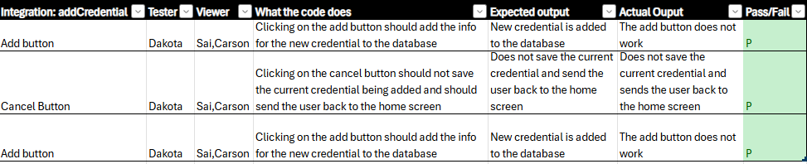
Integration Test Results
INTRO
Dakota, Carson, Sai
Team Organization
Software Requirements
IT 1.
IT 2.
Software Design
IT 3.
Test Overview
IT 4.
Traceability Matrix
IT 5.
Software Demonstration
IT 6.
IT 7.
Reflection

Slide 26
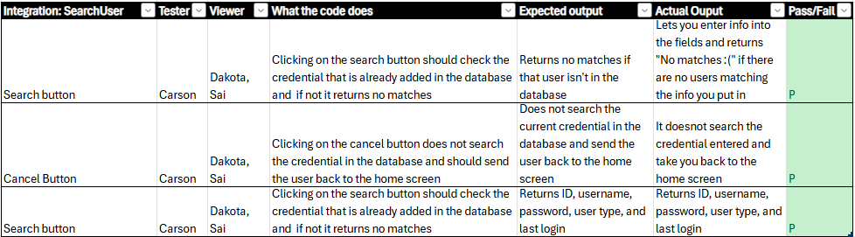
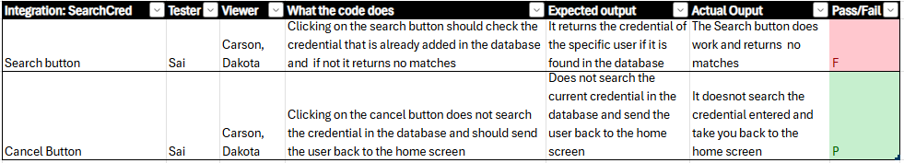
Integration Test Results
INTRO
Dakota, Carson, Sai
Team Organization
IT 8.
Software Requirements
Software Design
IT 9.
Test Overview
IT 10.
Traceability Matrix
IT 11.
Software Demonstration
IT 12.
Reflection

Slide 27
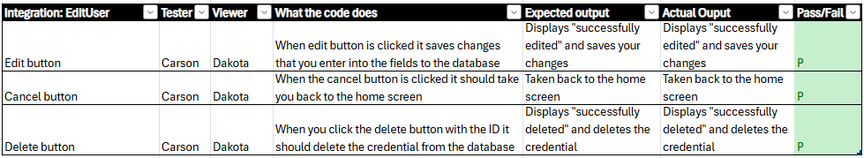
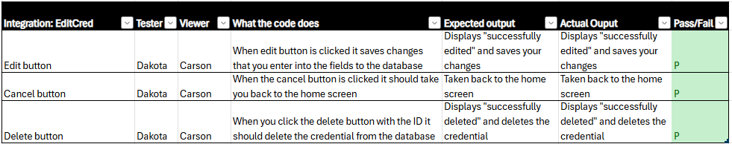
Integration Test Results
INTRO
Dakota, Carson, Sai
Team Organization
IT 13.
Software Requirements
IT 14.
Software Design
IT 15.
Test Overview
Traceability Matrix
IT 16.
IT 17.
Software Demonstration
IT 18.
Reflection

Slide 28
Traceability Matrix
INTRO
Team Organization
Software Requirements
Software Design
Test Overview
Traceability Matrix
Software Demonstration
Reflection

Slide 29
Traceability Matrix
Intro
Chhavi, Andrew
Team Organization
Design Component | Requirement Description | Test Case #
Performance Requirements
System Architecture | The software shall support 10 users while maintaining a maximum response time of 2 seconds. | n/a
User Interface | The software shall exhibit response times of between 0 and 2 seconds after user input. | n/a
Server Infrastructure | Unplanned extended downtime shall not exceed 1 minute each week. | n/a
Authentication Module | The software shall support a minimum of two users altering credentials at the same time. | n/a
Software Requirements
Software Design
Test Overview
Traceability Matrix
Software Demonstration
Reflection

Slide 30
Traceability
Matrix
Chhavi, Andrew
Intro
Design Component | Requirement Description | Test Case #
Team Organization
Security Requirements
Encryption Module | Admin passwords shall not be obtainable by any user but that specific admin. | n/a
Access Control | Data log access shall only be available to Admin users. | n/a (but, true)
Encryption Module | All data transfers containing user data shall be encrypted. | n/a (but, true)
Session Manager | Sessions shall expire after an inactivity of 30 minutes. | n/a
Compliance Module | The software shall enforce password authentication requirements following the NIST Digital Identity Guidelines (SP 800-63B). | M13, M14, M15, M16
Authentication Module | Accounts shall lock after three repeated failed login attempts. | n/a
Database Security | For any database login, a minimum of AES encryption shall be used before authentication. | M13, M14, M15, M16
Backup System | The software shall prevent data loss of user credentials by completing daily backups of all files to a secondary location. | n/a
Database Access Control | All interactions with the database shall access the database with the least privilege possible for the least amount of time. | M9, M10, M11, M12
Software Requirements
Software Design
Test Overview
Traceability Matrix
Software Demonstration
Reflection

Slide 31
Traceability Matrix
Chhavi
Intro
Design Component | Requirements Description | Test Case #
Team Organization
Software Quality Attributes
Modular Design | The software shall be divided into a minimum of 2 components that can be modified individually. | IT 1-18
Modular Design | Components shall allow the ability to update without affecting other parts of the system. | M 1-16 V 1-21
Documentation | Software shall be accompanied by documentation. | n/a (but, true)
Security Framework | The software shall protect against unauthorized access and data breaches. | n/a (not, true…)
Software Requirements
Software Design
Test Overview
Traceability Matrix
Software Demonstration
Reflection

Slide 32
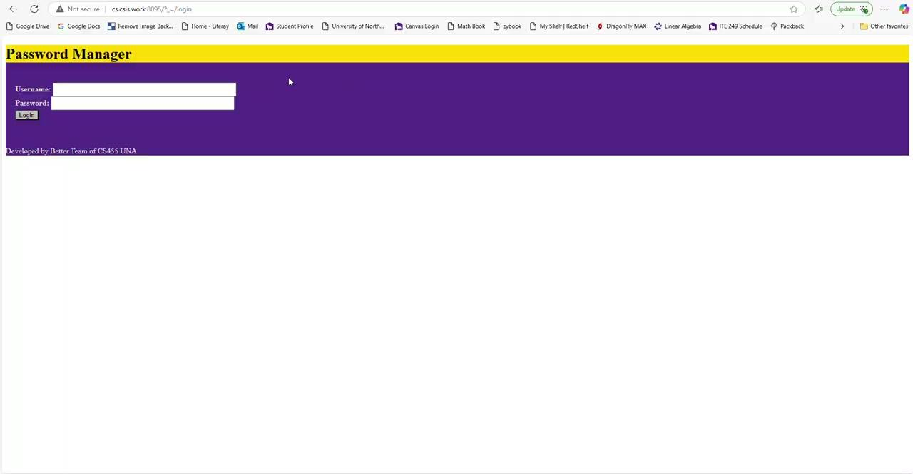
Software Demonstration
INTRO
Montana
Team Organization
Software Requirements
Software Design
Test Overview
Traceability Matrix
Software Demonstration
Reflection
Notes:
First type of user we are gonna look at is the view only user type
-every user is shown their credentials upon log in
-view only users are only able to search their credentials
-all of the text boxes work to search with except password
-once searched, the credential record is shown in the results box
-searching by credential ID 111 fails, since the user isn’t able to access the admin credential with this ID
-upon failure, the user is taken to the search failure status view
-when searching with this username, there are multiple credentials that apply and they are all outputted
The next type of user is the regular user type
-does everything view only can but can also add credentials
-when adding credentials all fields must be filled to succeed
-the new credential is added to the bottom
Now here's when things get more fun, admin users have all the past functionality and can also edit credentials and search, edit, and add users
-search credentials shows all user’s credentials
-searching includes all user’s credentials with ending with their user ID (1 and 3)
-lets edit the first credential to change the username from admin username to testing
-updated credential is displayed
-now lets delete that credential
-updated credential is displayed
-search users shows all user’s with their passwords hashed for security
-all boxes can be used to search except user type which we didn’t get to
-pretty much same setup as search credentials
-now lets add a new user with the username testing
-and it shows up on the list of all users
-we can edit the user by changing their username to testing
-and the updated user information is displayed
-and lastly, we can delete that user we just made and its gone from the list of users

Slide 33
Reflection
INTRO
everyone
Team Organization
Model unit testing allowed us to fix and isolate problems.
SDD and SRS are important to spend less time on deciding how the app should behave (we forgot some design screens)
Would have benefitted from being trained on whitty, sql interfacing.
Software Requirements
Software Design
Test Overview
Traceability Matrix
Software Demonstration
Reflection

